Slide 1

Geographical Statistics of Engineering Internships
CYLIA BERKANE
FAGNUO CAI
GUSTAVO FLEURY
INDURAJ PR
QUOC VIET PHAM
YEN CHU CHEN
April / 2019
Notes:
As próximas visitas serão compostas por 2 consultores;

Slide 2
AGENDA
1
Management Solution
3
Next Steps
2
Technical Solution

Slide 3
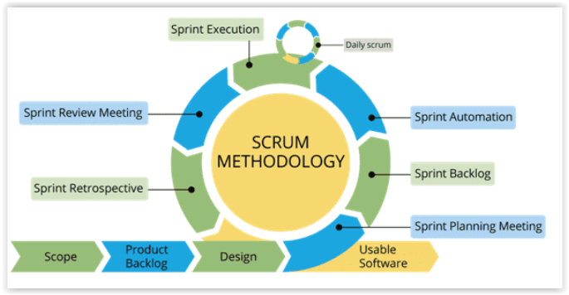
Management Solution
Notes:
This week basically: Scope, Start of Product Backlog and Design.

Slide 4
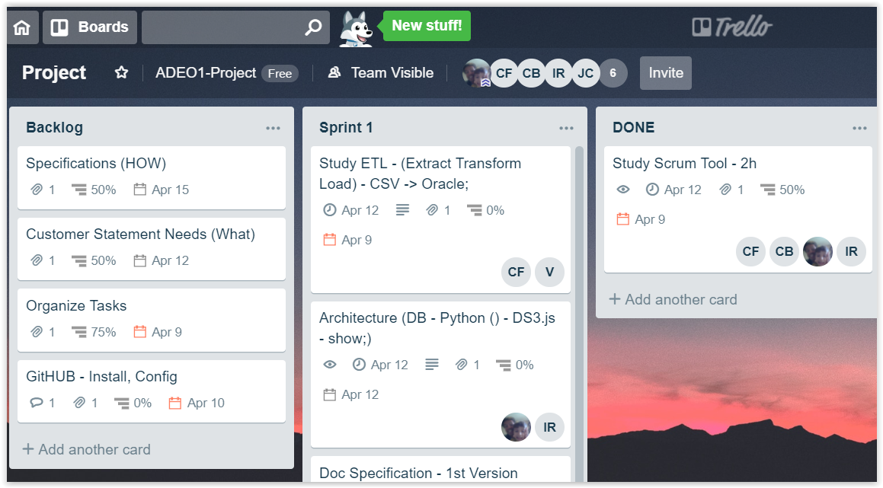
Management Solution - Trello
Notes:
Trello:
- Backlog;
Actual Sprint;
Done;

Slide 5
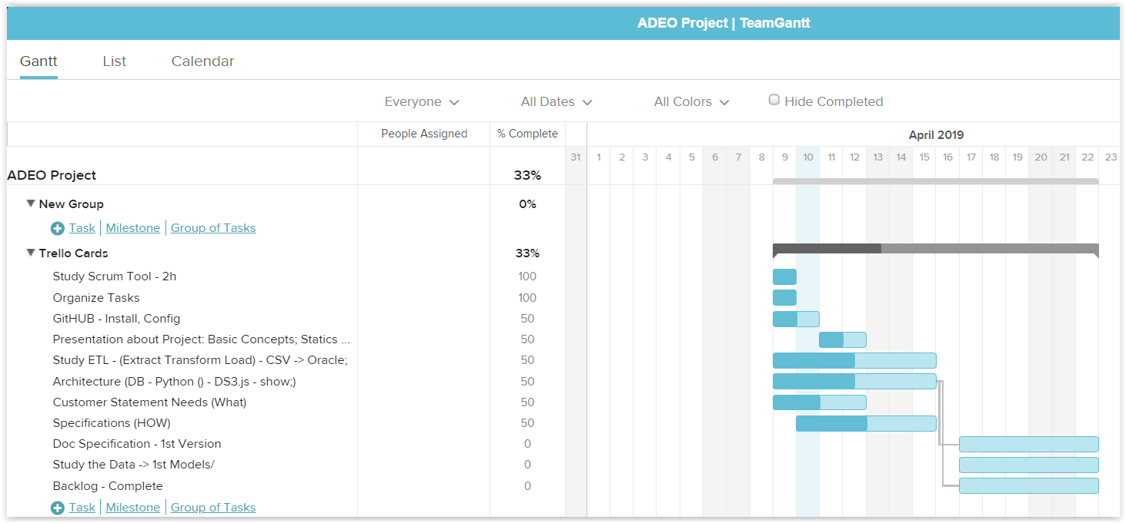
Management Solution - TeamGantt
Notes:
TeamGantt:
Percentage;

Slide 6
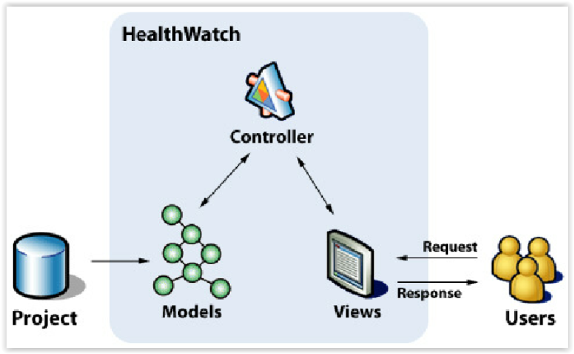
Technical Solutions - MVC

Slide 7
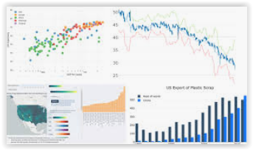






Technical Solutions
Dash
Framework
Python
ETL
Oracle

Slide 8
Next Steps
Finish Especification Document;
Define the Framework and main Graphs tools;
Create the 1st model using apps (Ex: ScatterPlot)
Complete the Backlog;
Prioritize the Backlog;

Slide 9
Thank you!
Questions?

